Slide 1

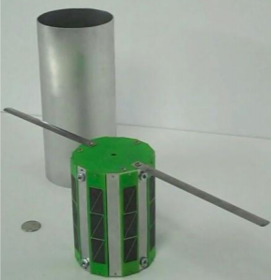
KK01: Design of Extremely Miniature Satellite (RyeTubesat)
Department of Aerospace, Electrical, Computer & Biomedical Engineering
Ryerson University, Toronto, Canada

Slide 2
PRESENTATION OUTLINE
Overview
System Analysis
System Revisions
Hardware Overview
Software Overview (Communication Modem)
Command and Data Handling
Payload
Challenges
Future Actions

Slide 3
OVERVIEW
AFTER JOINING UP WITH TUBESAT TEAM
Assess current issues with the tubesat project
Provide solutions to project when available
Decide with current Tubesat Team future revisions and actions to be done to project

Slide 4
SYSTEM ANALYSIS - POWER
Component | Operating Power (W) | Idling Power (W)
Light sensor**has been changed | 0.0018 | <0.000045
Temperature Sensor | 0.0011 | <0.000045
IMU: Accelerometer Magnetometer Gyroscope | 0.0005 0.0004 0.0234 | 0.00009 0.00000432 0.0000105
Camera | 0.375 | 0.0
Radio Transceiver: Transmit | 0.55 | 0.0
Radio Transceiver: Receive (always on) | 0.135 | 0.135
Amplifier: Transmit | 1.25 | 0.0
Amplifier: Receive | 0.01 | 0.01
P_{Total} | 2.3472 | 0.1452
Battery Properties
Nominal Capacity (maH) | 5200
Voltage (V) | 3.7
Efficiency (%) | 90

Slide 5
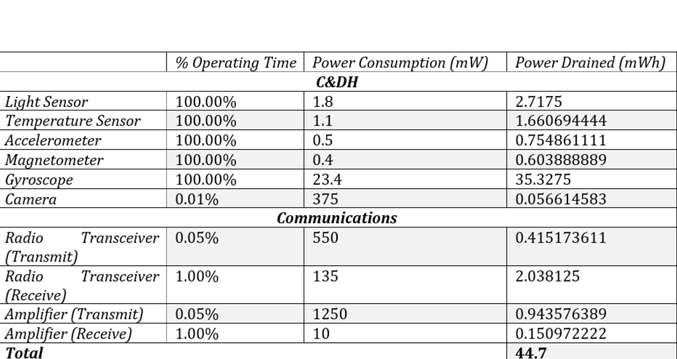
SYSTEM ANALYSIS - POWER

Slide 6
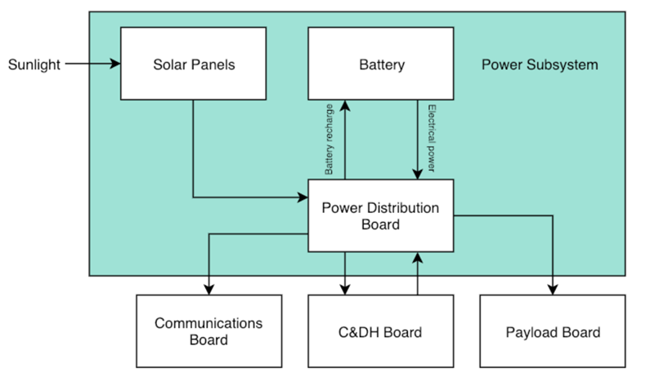
SYSTEM ANALYSIS - POWER

Slide 7
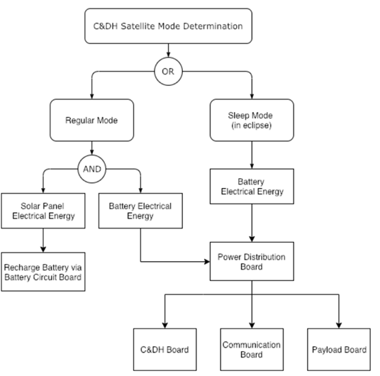
SYSTEM ANALYSIS - POWER

Slide 8
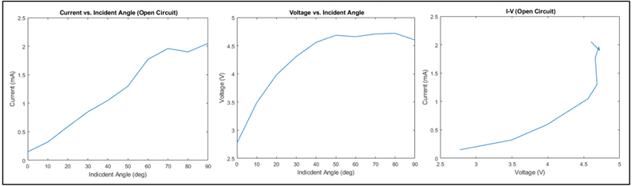
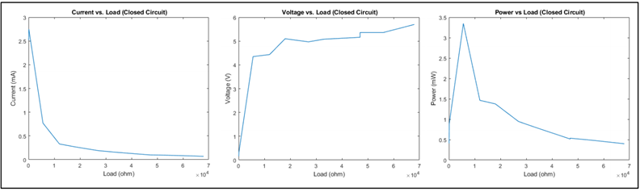
SYSTEM ANALYSIS - POWER
Open Circuit Test
Short Circuit Test

Slide 9
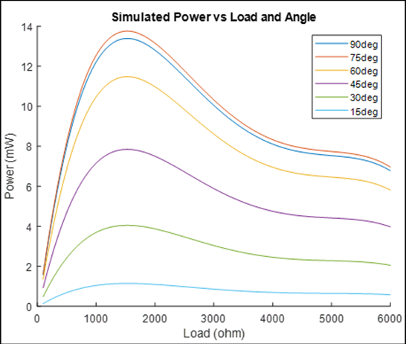
SYSTEM ANALYSIS - POWER

Slide 10
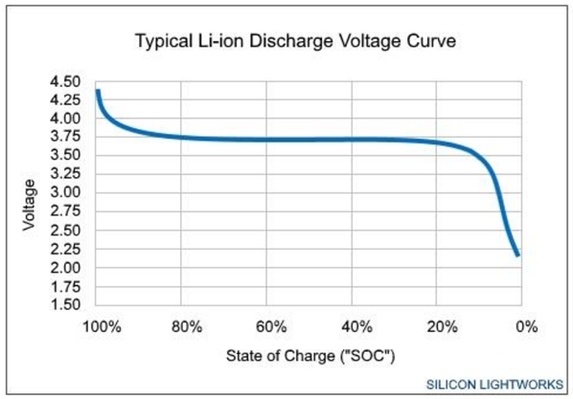
SYSTEM ANALYSIS - POWER

Slide 11
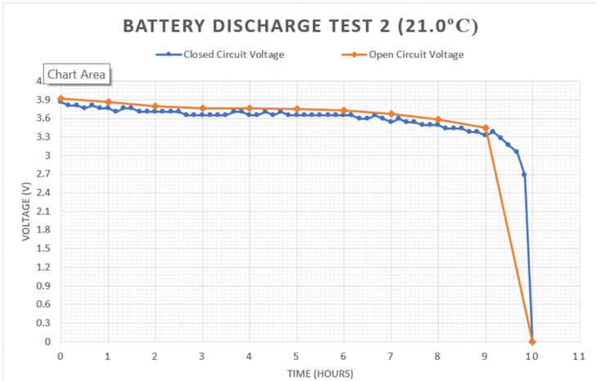
SYSTEM ANALYSIS - POWER

Slide 12
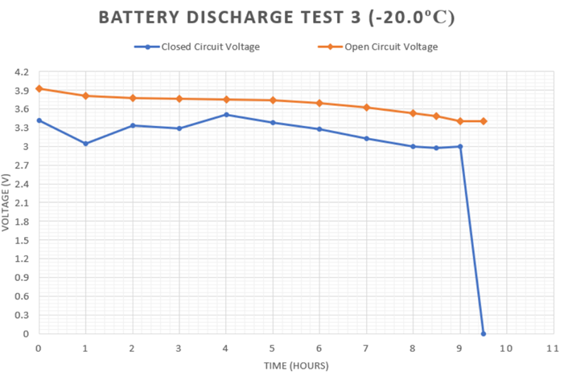
SYSTEM ANALYSIS - POWER

Slide 13
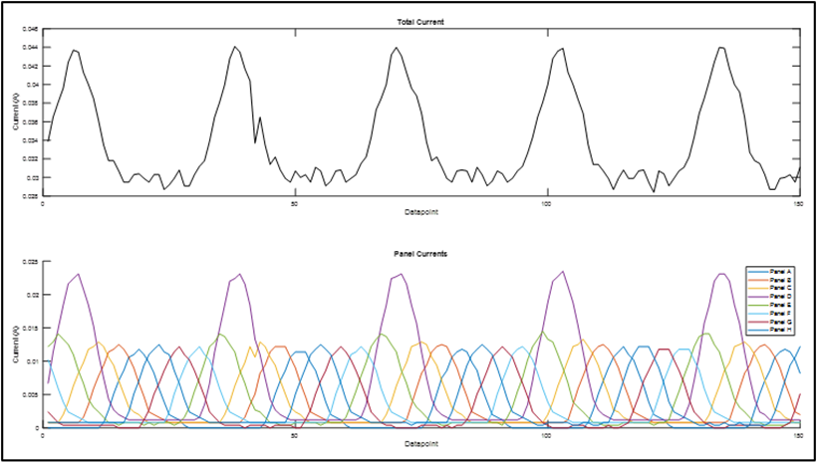
SYSTEM ANALYSIS - POWER

Slide 14
SYSTEM ANALYSIS - POWER
EXISTING POWER SPECIFICATIONS:
Maximum System Operating Time: ~16 hours
Approximate Solar Panel Power Delivery: 15mW
System cannot operate indefinitely
Must alternate between data collection and charging cycles

Slide 15
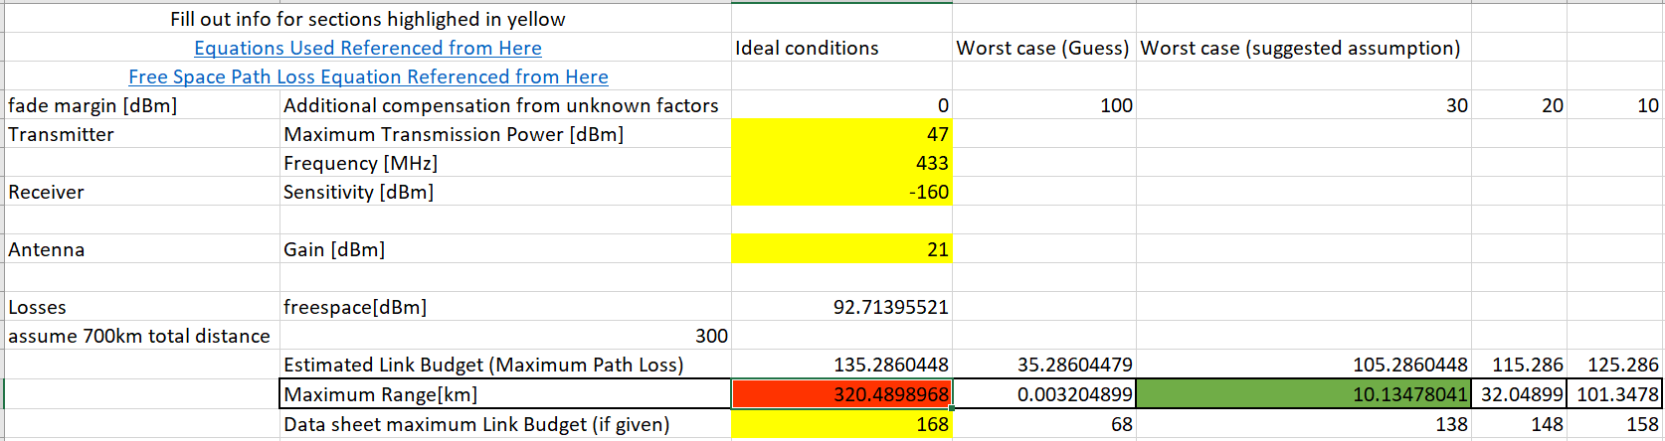
SYSTEM ANALYSIS - LINK BUDGET

Slide 16
SYSTEM REVISIONS
Issues to Be Fixed
Neccessary Documentation/Information on Communication System (Wiring, Troubleshooting Guide, Pin Description, Source Code template, etc) was not available; Only mechanical information was found
Arduino Mini Unreliable during Programming
SD Card Slot Not Attached For Payload Team on Board(s)
Cable Connections on-board loose (no locking feature available)
Unused components and wasted space
Available Program Memory insufficient for required Functions
Multiple Test Models and Parts Unavailable; Only one test at a time

Slide 17
SYSTEM ANALYSIS - LINK BUDGET
EXISTING SYSTEM SPECIFICATIONS:
On Board Transmission Power: 100mW(20dBm) + 250mW(27dBm) amplification
High Ground Station Sensitivity (Larger Ground Antenna)
Operating Distance: 300 km
Data Rate: 1200 baud
AX.25 Protocol (Used for radio communication)
64 Bytes/packet
Single Payload Transmission: < 1 min (0.017 Hr. )

Slide 18
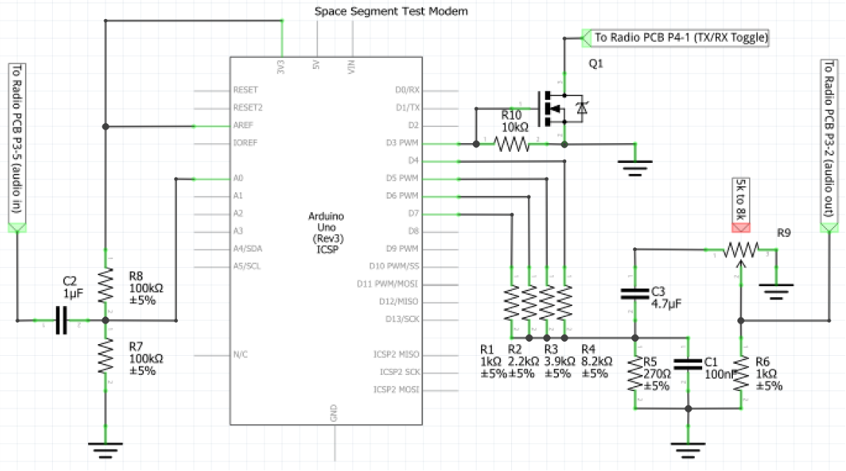
SYSTEM REVISIONS
Arduino AX.25 Modem

Slide 19
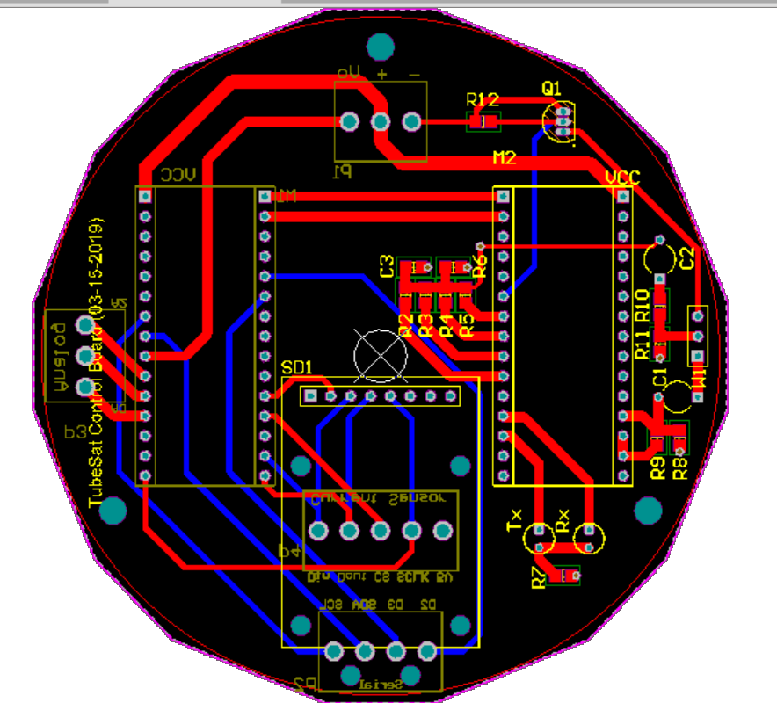
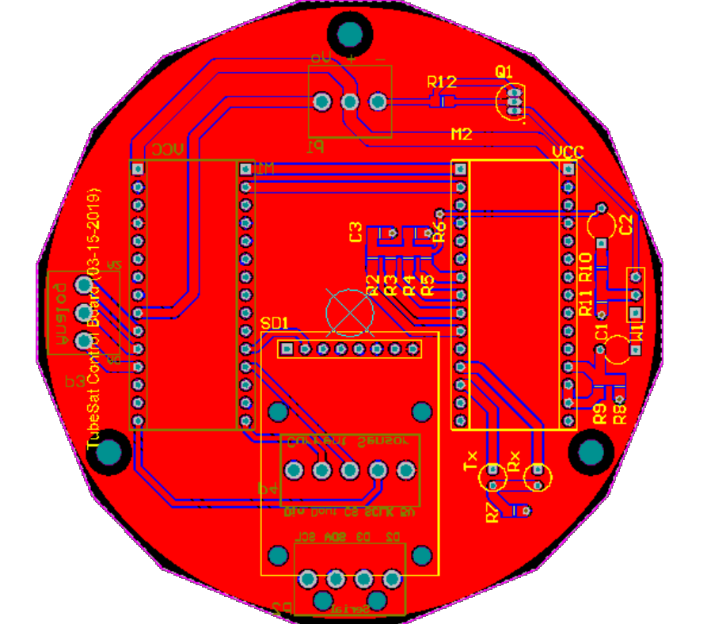
Final Design Overview
SYSTEM REVISIONS
Revised Controller Board

Slide 20
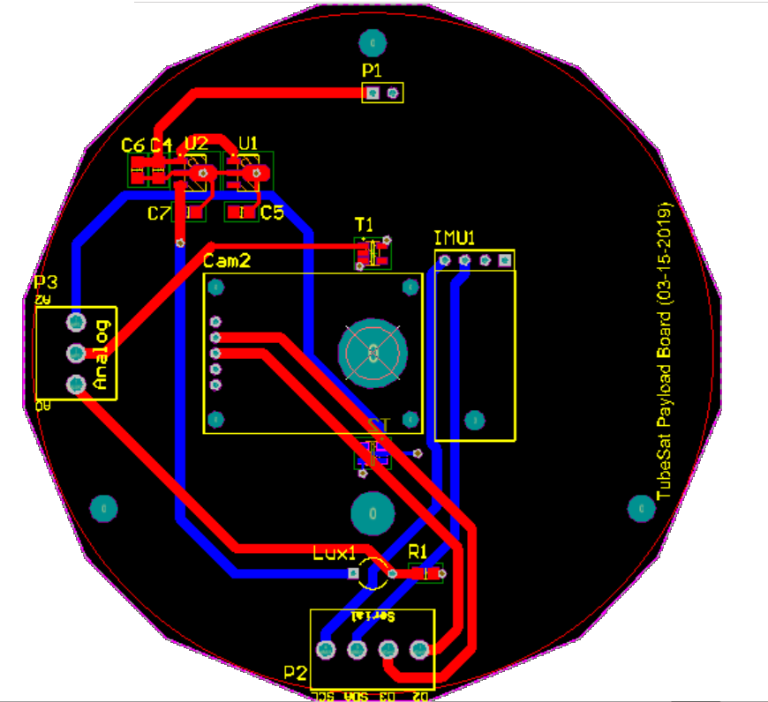
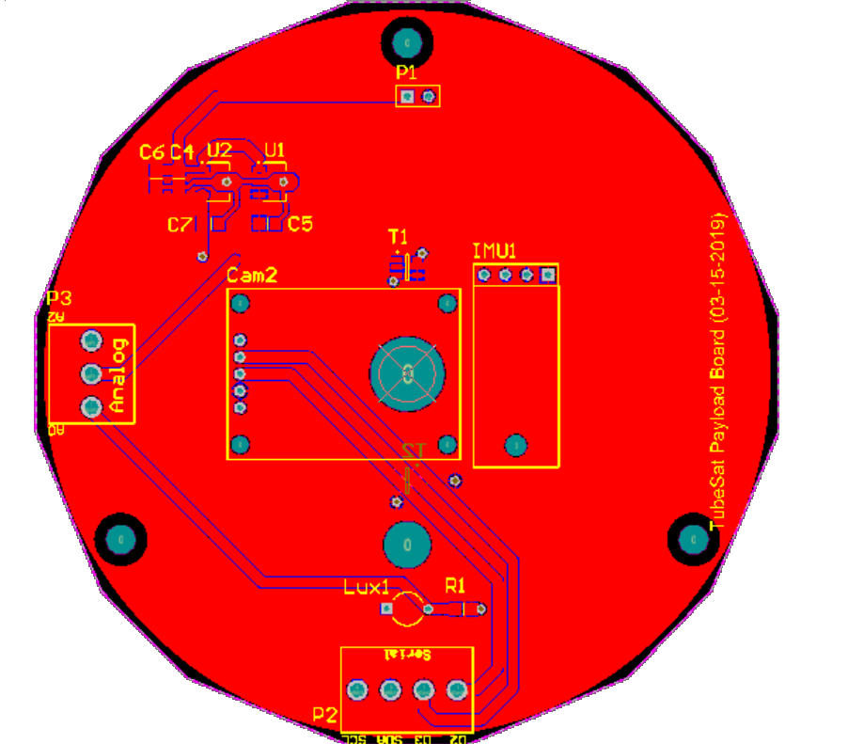
SYSTEM REVISIONS
Revised Payload Board

Slide 21
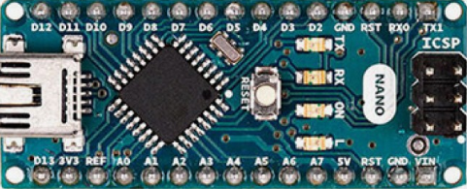
HARDWARE OVERVIEW
Logic Controller (x2)
Arduino Nano
16MHz 5V
built-in 5 & 3.3V DC Regulator
30kB Program Memory
5V ADC, 5V IO, SPI, I2C, UART

Slide 22
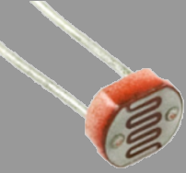
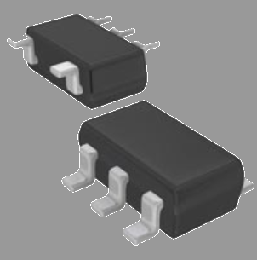
HARDWARE OVERVIEW
Analog Voltage Devices
CDS Photoconductive Cells
5V Operating Voltage
TMP35 Low Voltage Temperature Sensors
3.3V Operating Voltage
Output Voltage: 0 - 3.3V

Slide 23
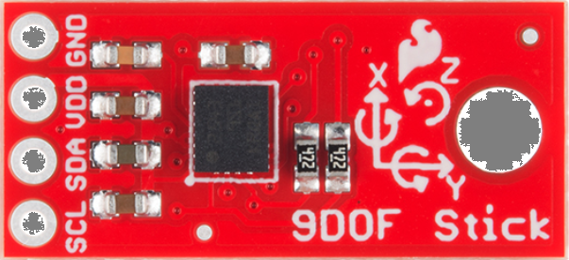
HARDWARE OVERVIEW
I2C Devices
LSM9DS1 motion-sensing system-in-a-chip
3.3V Operating Voltage

Slide 24
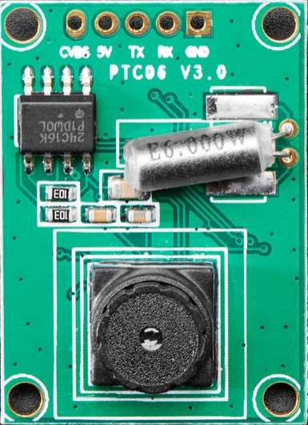
HARDWARE OVERVIEW
UART Devices
Miniature TTL Serial JPEG Camera with NTSC Video
5V Operation

Slide 25
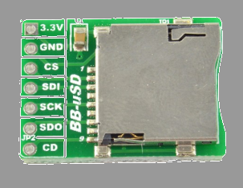
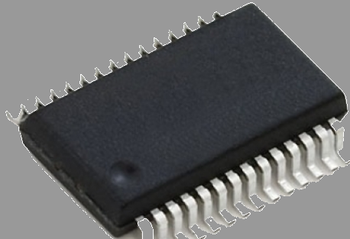
HARDWARE OVERVIEW
SPI Devices
SD Memory Card Reader
3.3V Operating Voltage
MAX1112 multichannel 8bit ADC
5V Operating Voltage

Slide 26
RyeTubeSat: Command and Data-Handling Software
Collect data such as acceleration, satellite orientation, light intensity, and a real time photo, then sends all gathered data to ground station
Arduino Mini
During start up, the software launches mission level code
checks if satellite is undergoing launch
if so, a 45 min timer will begin for all satellite function to start
launch duration = 20min → 25 min safety window
Continuously checks for any signal from the ground station. Once it receives a signal from the ground station, it will then start sending the collected data to the ground station and stored
If it does not receive a signal from ground station then it will perform payload tasks such as take photos and collect sensor data.

Slide 27
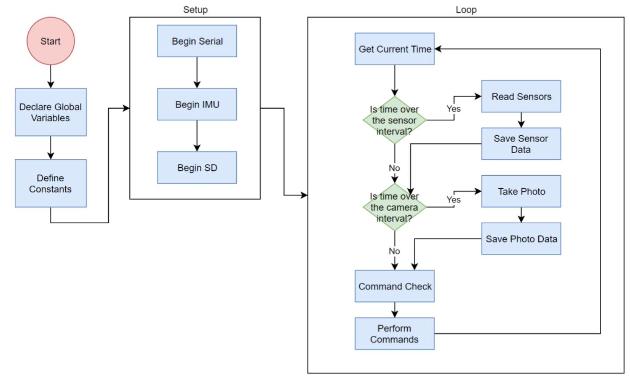
RyeTubeSat: Command and Data-Handling Software
Work Break Down Structure
High-level view of how the code works

Slide 28
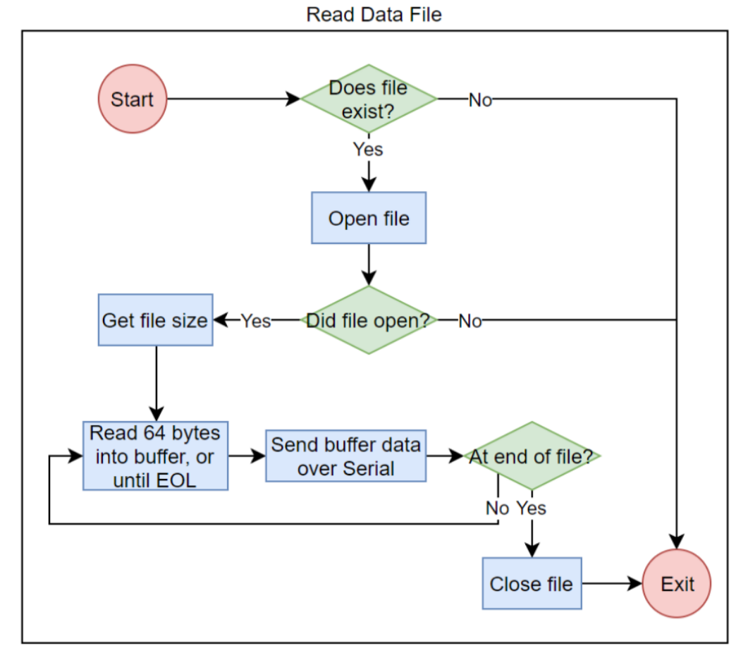
RyeTubeSat: Command and Data-Handling Software
Work Break Down Structure
Work Break Down Structure
Explanation of the function that reads data

Slide 29
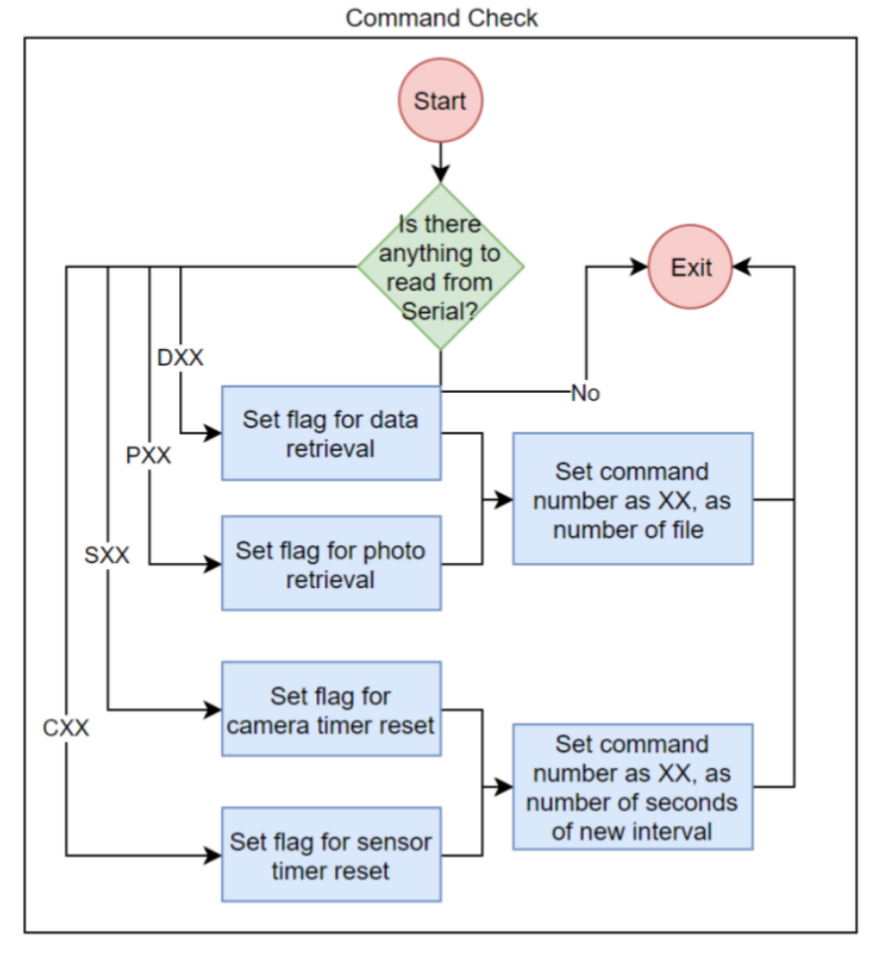
RyeTubeSat: Command and Data-Handling Software
Work Break Down Structure
Commands and their tasks

Slide 30
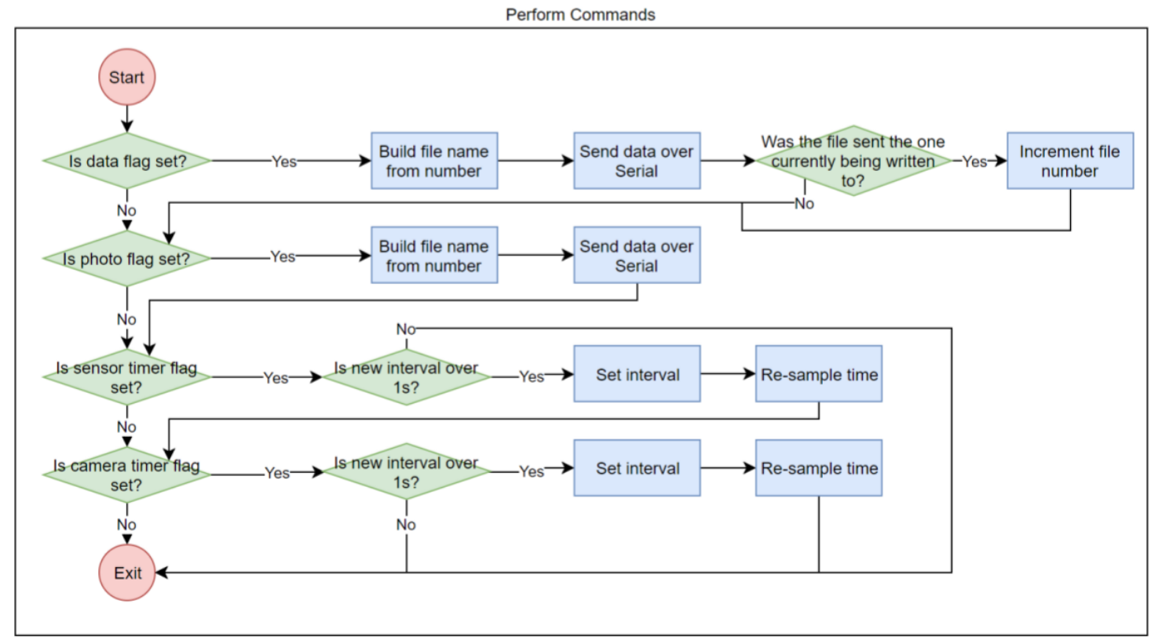
RyeTubeSat: Command and Data-Handling Software
Work Break Down Structure
Performance of commands

Slide 31
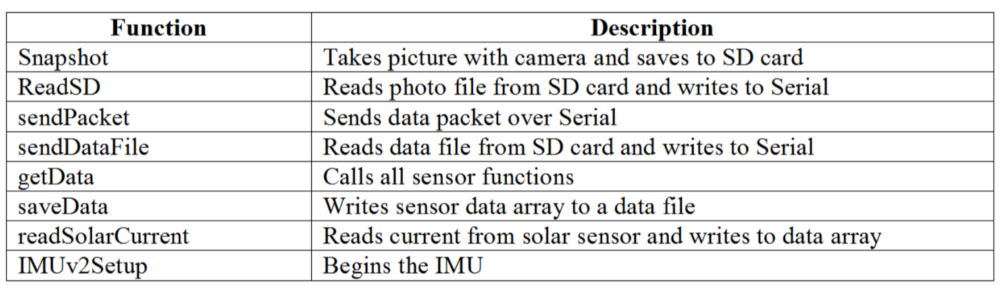
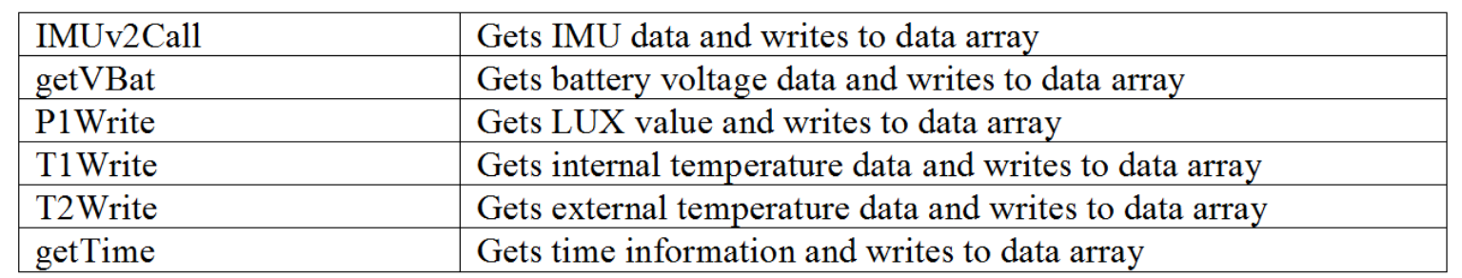
RyeTubeSat: Command and Data-Handling Software
List of Functions

Slide 32
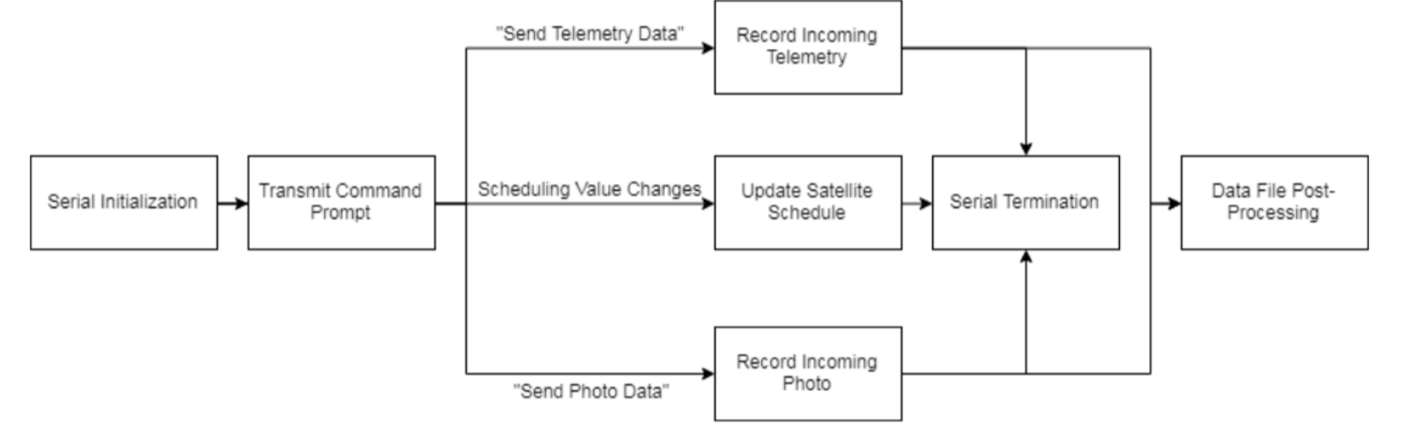
RyeTubeSat: Ground Station Software
Ground System Block Diagram
MATLAB
Software is broken down into separate module that each play a part in communicating with the satellite and can be called anytime at the discretion of the ground station operator

Slide 33
RyeTubeSat: Software Problems and Revision
Memory
Timing Contraints
Software Platform
overall efficiency

Slide 34
CHALLENGES
Troubleshooting the communication system in less than 4 months without proper prior documentation/information of the system
Large Portion of the system being treat as black boxes; unknown systems not properly documented for handling and operation
Lead times of components for board revisions
Lack of additional test units for concurrent testings of Systems
Limitations of control over project; Decisions must never be made by one party alone

Slide 35
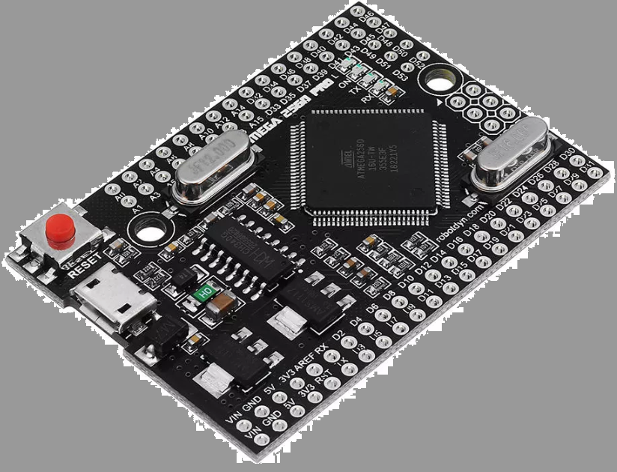
FUTURE REVISIONS
Further Simplification of System; Switching to Larger Arduino Microcontroller
Fixes Program Memory Issue with current System
Provides enough ADCs for direct, more accurate current measurement of solar panel current
Changing Operating frequency balances out increased system power
Apply Call sign/Handshake Protocol on Arduino Modem to decrease bit error rate to 0%

